Slide 1
Duplicate Words Finder & Deleter in DSA C++
Submitted to,
Muhammad Adnan Aslam
Presented By,
Danial Saleem(221825)
Muhammad Faseeh(221839)

Slide 2

What is Our Project:
Our Project is to Find Duplicate words in two Different files !
Our Project will list out the Duplicate words from each file and it will display their names on the Screen.
Our Project will also provide us a option to keep those duplicate word or either we want to delete them.

Slide 3
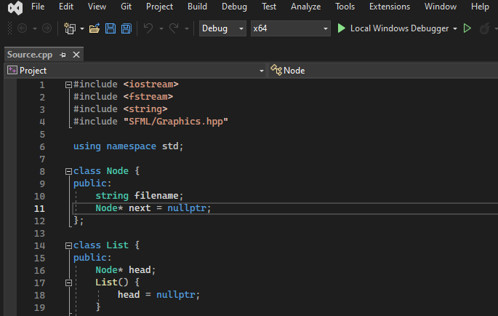
As We Have Used SFML Library for User Interface
What is SFML ?
SFML (Simple and Fast Multimedia Library) is a free and open-source multimedia library written in C++.
We have used this library for our Graphical User Interface.

Slide 4
As We Have used file Handling in our program.
What is File Handling?
File handling operations involve reading from and writing to files, as well as performing various tasks through a Program. As we have included ifstream as it is a combination of istream (which is a file input stream) and ostream (which is a file output stream).

Slide 5
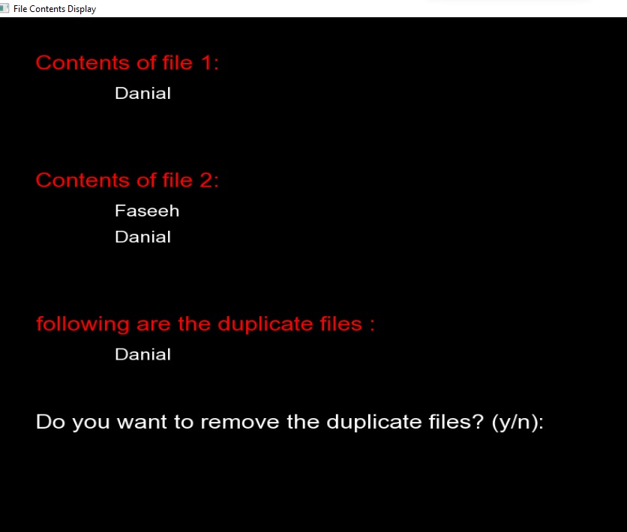
Content of Files
This shows the content of file 1 which contains a word Danial.
The second box shows the contents of file 2 which contains word Faseeh, Danial

Slide 6
Display of Duplicate Files
Our Program has searched duplicate words in both files and it has displayed it on the screen.

Slide 7
Deletion of Duplicate word
Now the Program has allowed the user that either he wants to delete the word or he don't want to delete the duplicate word.
If the user press n then program will not don’t delete the duplicate word.

Slide 8
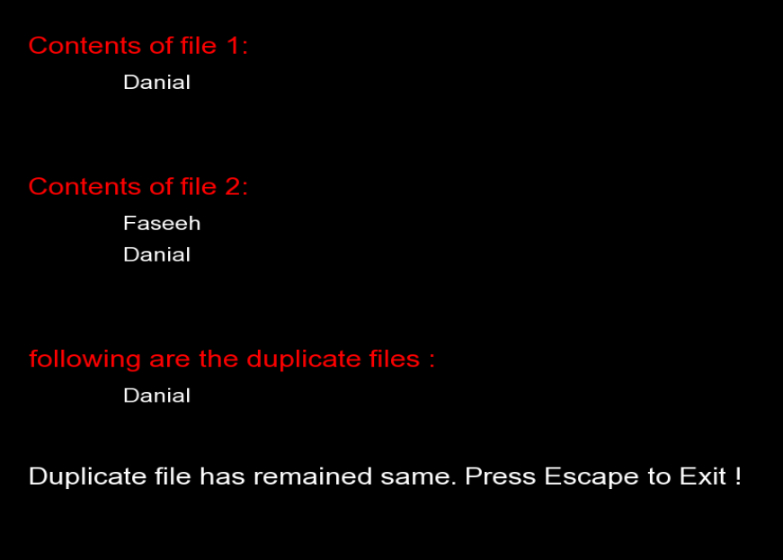
When the user Don’t wants to delete the word
When the user press n which represents No then the duplicate words remain the same.
Then the program allow the user to exit by pressing Escape !

Slide 9
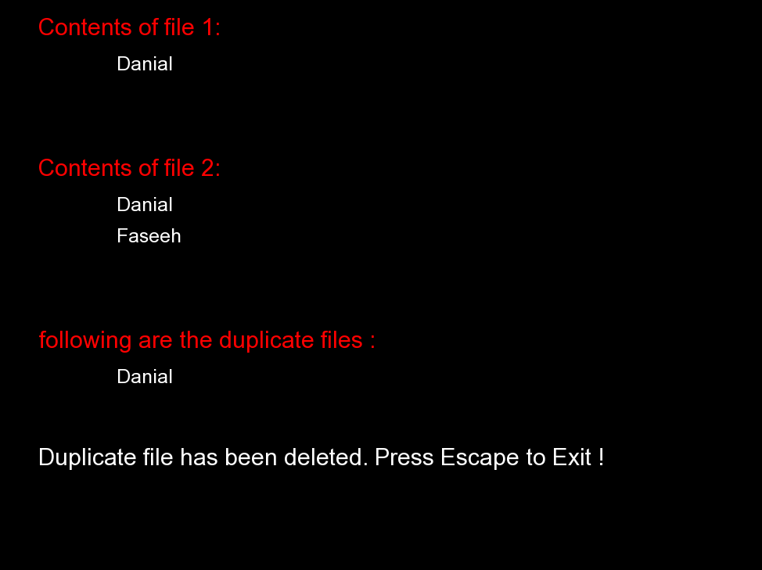
When the user want to delete the Duplicate Word.
When the user press y which represents yes then the duplicate words is deleted form one file.
Then the program allow the user to exit by pressing Escape !

Slide 10
Thanks.

